Slide 1
Early Reading at NLPS
1.11.23

Slide 2
The basics needed for learning to read:
Story telling and comprehension
Able to hear and say initial sounds in words
Able to orally blend and segment “c-a-t”
At NLPS we follow the ‘Little Wandle Letters and Sounds Revised’; this is a structured programme which introduces pupils to phonemes and graphemes in a specific order within the context of a language-rich curriculum. By following the ‘Little Wandle Letters and Sounds Revised’ programme effectively, pupils are able to see the relationship between reading and spelling from an early stage, such that the teaching of one reinforces understanding of the other.
20 minutes every day
Learn new sounds
Blend sounds together to read words
Segment sounds to spell words

Slide 3
EYFS Autumn Term (phase 2)
Remember to use the pure sounds!
mmm not muh
lll not luh
b-a-t
Not bu-a-tuh!

Slide 4
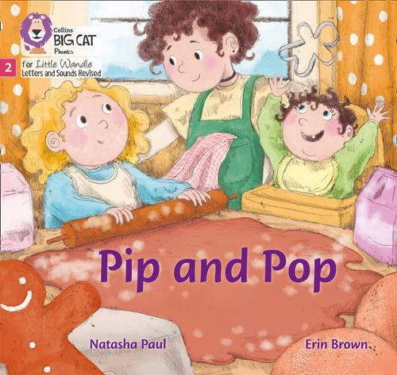
EYFS Autumn Term
Practising at home
EYFS children have been given an envelope with sounds in to practise recognising the sounds, and blending to read words.
- Quick sound recognition helps automaticity, which helps to blend the sounds to read the words.
Blending sounds to read words (video from Little Wandle)
Phase 2 reading books

Slide 5
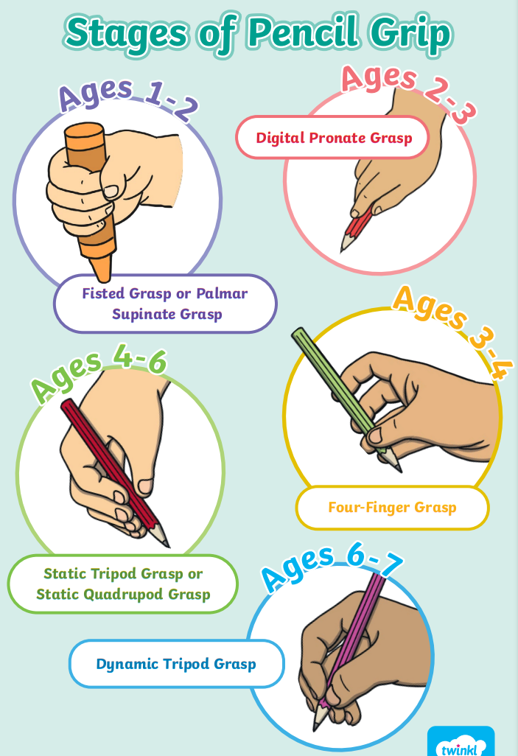
Early writing
Both phonics and writing interlink
Fine motor skills & pencil grip
Correct letter formation & letter size

Slide 6
Phase 3
EYFS Spring & Summer Term
(Yr 1 Autumn Term Recap)
digraphs and trigraphs
park
beard
. _ .
. __ .

Slide 7
Phase 5
Year 1
Alternative graphemes
ai
tail
play
snake
eight
straight
grey
break

Slide 8
Tricky words
Quick recognition (by sight) supports children’s fluency in reading
Little Wandle Video
Year 1 spellings

Slide 9
Year 1 phonics screening (June)

Slide 10
https://www.amazon.co.uk/Little-Wandle-Phonics-Flashcards-Reception/dp/000856373X/ref=sr_1_5?crid=1TTMWEDFNA3LZ&keywords=collins+flashcards+phonics&qid=1698831611&sprefix=collins+flashcards+phonic%2Caps%2C218&sr=8-5
https://www.amazon.co.uk/s?k=little+wandle+phase+3&crid=32PHS92XB1U88&sprefix=little+wandle+phase+%2Caps%2C99&ref=nb_sb_ss_ts-doa-p_3_20
More information available on our school website → reading and phonics
Little Wandle website (parent section).
Remember to foster a love of reading (it’s not all about phonics!)
Keep asking questions, checking understanding, and retelling the books that have been read.
Children can also take a book home for parents to share with them at home,
for enjoyment.

