Slide 1
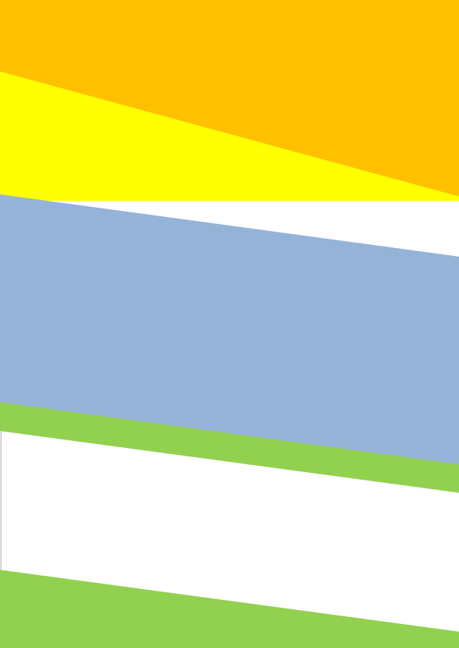

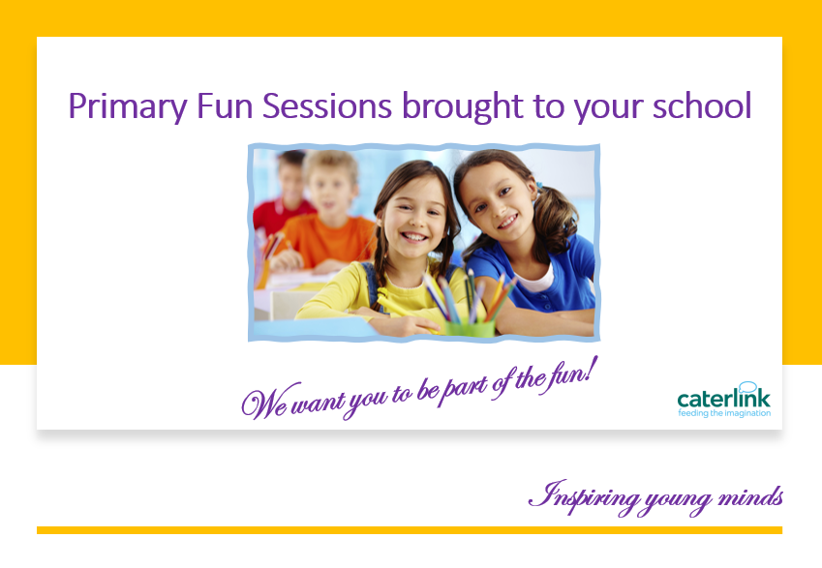
Welcome to Caterlink
We love food and hope you will love what we provide for you at your school.
We embrace natural ingredients, love seasonal produce, and develop ethical trading with many of our suppliers. Our meat, fruit & vegetables and bakery is all sourced from suppliers as near to the school as we can.
We are delighted to be working in partnership with your school and would like to tell you about us and our catering services.
The Great things we do!
Make Fresh Bread Daily
Menus can be found on your school website.
Keeping in Touch! You can also keep in-touch with us through our web site, where we advertise menus, job vacancies and news. www.caterlinkltd.co.uk
Caterlink, Hop House,
Lower Green Road, Pembury,
Tunbridge Wells,
TN2 4HS
01892 824604
info@caterlinkltd.co.uk
www.caterlinkltd.co.uk
Use Fresh Food Every Day!
Help to save the planet
Have taster sessions
Have additional activities
Menus to suit your pupils
Themed Days
Inspiring young minds

Slide 2
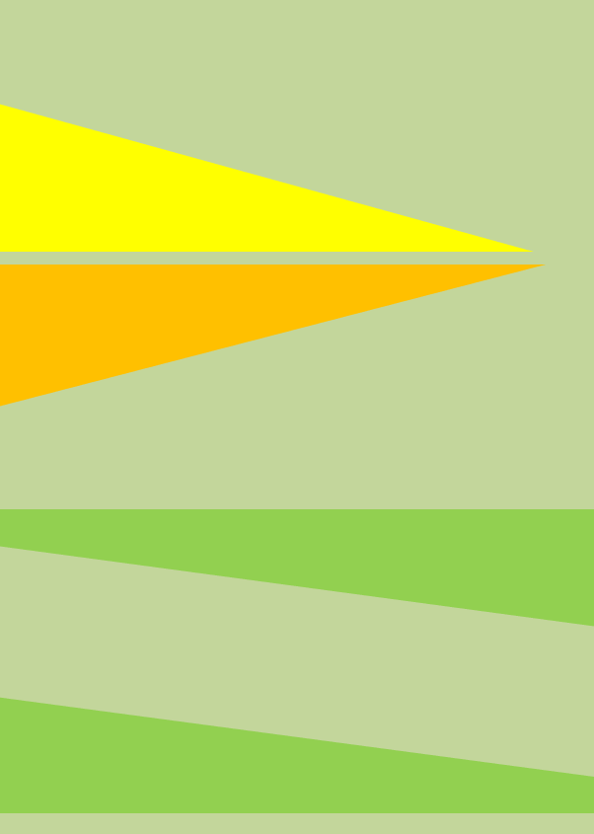
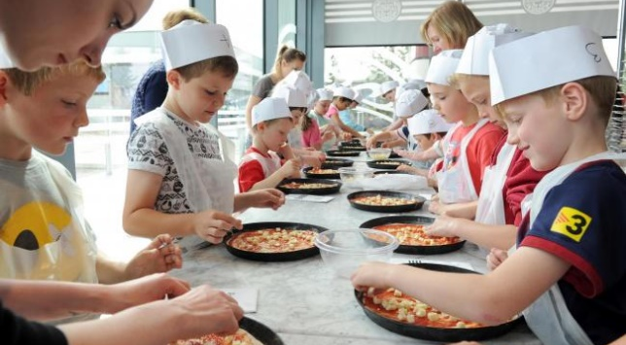
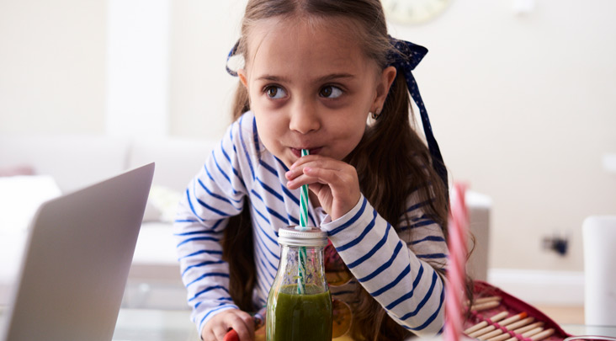
What happens in School!
We cook bread daily and your children can join in the fun when we host an event for the pupils to join in.
A few of the activities we host are:
Bread Making Sessions
Parents Afternoon Tea Parties
Breakfast Yoghurt Bars
Fitness Fun with Smoothie making
Assemblies on Nutrition and Food
There are loads to choose from!
We cannot wait to meet you!
Innovation and Menu Planning –
In line with Children's Food Trust recommendations, Caterlink have reduce the sugar within our desserts, ensuring that all contain 6.5g of free sugars or less. Helping to save the planet - We have developed a number of 50% plant-based protein dishes to our menus these are also a good source of protein and help reduce green house gasses than using meat and dairy. Plastic Reduction – We are keen to be leaders in reducing plastic within our kitchens and have removed the use of clingfilm, plastic cutlery, cups and reduced packaging from our suppliers.
Assemblies – We deliver assemblies to cover a wide range of topics such as healthy eating, hydration and food waste, some of which include live cooking demonstrations.
Chefs adopt a school – Our Development Chefs host these sessions where pupils learn to cook from raw basic ingredients including bread making, whilst exploring the 5 senses.
Kitchen gardens – Through our WSH Charitable Foundation, we are able to offer kitchen gardens where pupils can grow vegetable and herbs. This helps children understand where fresh produce comes.
Inspiring young minds

Slide 3
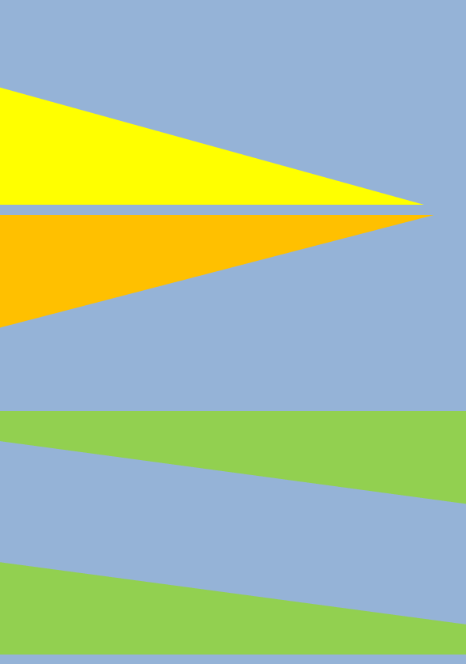
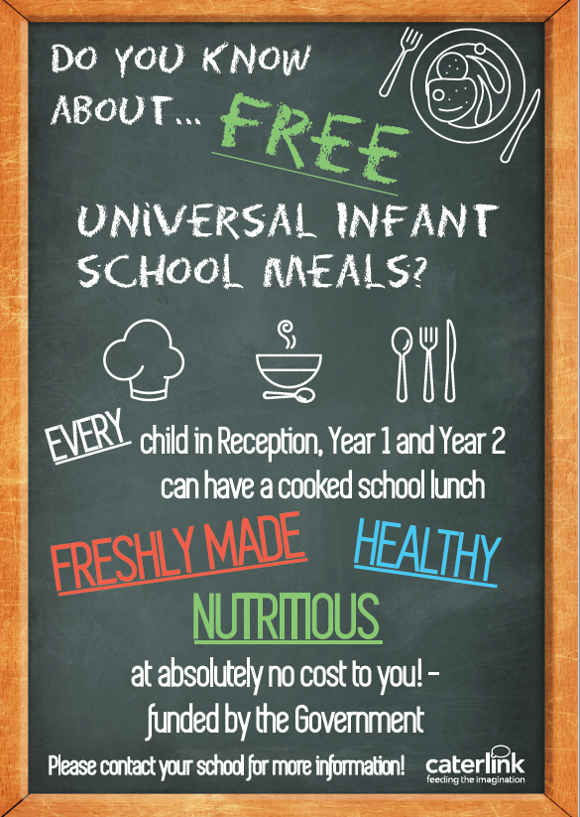
Information for you!
Inspiring young minds

